Slide 1
AD based attacks

Slide 2
What is AD?
Active Directory (AD) is a Microsoft technology used to manage computers and other devices on a network. It is a primary feature of Windows Server, an operating system that runs both local and Internet-based servers.
AD uses both NTLM and kerberos

Slide 3
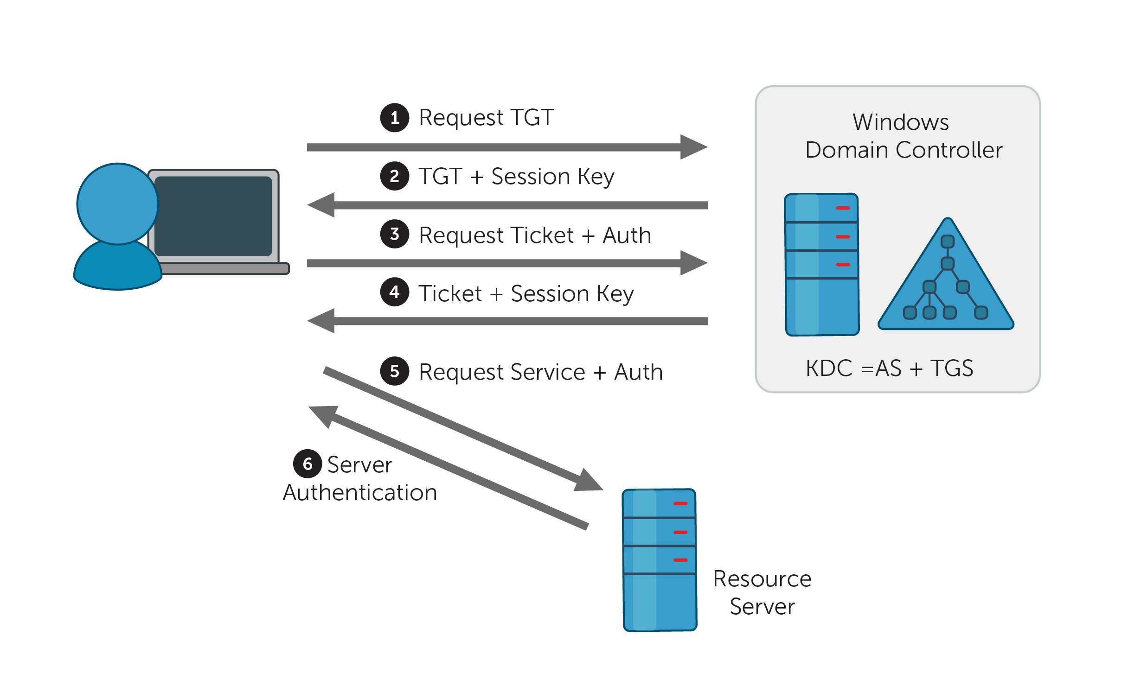
Lets talk kerberos

Slide 4
Attacks using kerberos
Brute forcing
Pass the ticket
Kerberoasting
AS-REP Roasting
Silver ticket
Golden ticket
Skeleton Key

Slide 5
Kerbrute ( No Domain access )
Kerbrute tool
  https://github.com/ropnop/kerbrute
  It gives us valid usernames with wordlist

Slide 6

Rubeus ( user in a domain )
Rubeus tool
https://github.com/GhostPack/Rubeus
Harvesting
Password spraying
Run a password spraying for all the users found having a .kirbi ticket
Kerberoasting
Gets the hash of the user requesting SPN service to be later brute forced
AS-REP roasting
→It fetches the hashes of the user account that have pre-auth disabled

Slide 7
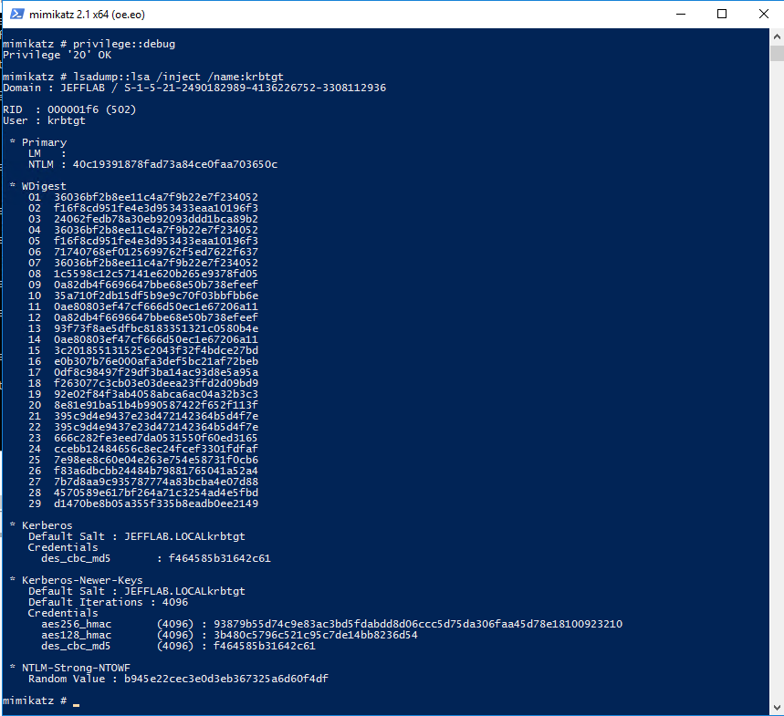

Mimikatz ( user in a domain/domain controller)
https://github.com/gentilkiwi/mimikatz
Passing the ticket
            →Dumps the tickets in the machine as .kirbi
                →Impersonate the ticket
Golden/silver ticket
→To dump the tickets for golden tckt
Instead of krbtgt, if we give user account we can gain silver ticket
To impersonate the ticket
→ to gain the elevated access

Slide 8
Mimikatz ( user in a domain/domain controller) - Contd
Persisitency
Injects a skeleton with mimikatz as the password to gain the access to the domain

Slide 9
NTLM hashes
NTLM hashes are used when used to access shares or SMB using IP addresses
We can create a responder server to steal the NTLM hashes

Slide 10
Q & A
What protocol does AD use?
What services does KDC have?
Which company created Active directory? and Which OS first supported AD?

Slide 11
Thank you

